Slide 1
Accessory Dwelling Units
as a solution for
Housing Shortage
Khairun Fahmi & Salma Haoudi
URSP 688Y

Slide 2
Brief background
FAHMI?

Slide 3
Defintions
ADU?
RLU?
ACC?

Slide 4

Research question

Slide 5
Research question
What is the correlation between Accessory Dwelling Units’ (ADU’s) development and proximity to metro stations in Montgomery County?

Slide 6
Objectives and Process
Measure homeowners demand for ADUs
Assess the potential number of RLUs that can become ADUs though regulatory streamlining
Assess the number of additional housing ADUs offered within 1 mile of metro station
How many ADUs, RLUs, and ACC3 are within 15 min walk from metro stops in Montgomery County?

Slide 7
Methods
FAHMI?

Slide 8
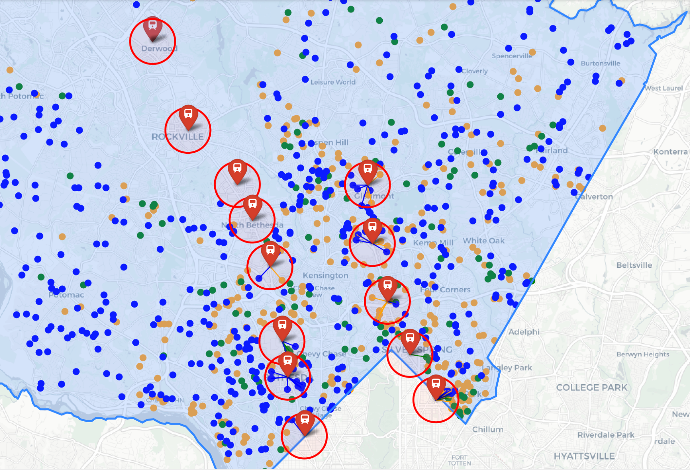
Results
Notes:
When mapping the different types of ADUs and the metro stops, it appeared to us that there is not specific correlation between ADU development and location of metro stations. In fact, if we look at Rockville station or Shady Grove for example, we see that the area does not show any ADU nearby.

Slide 9
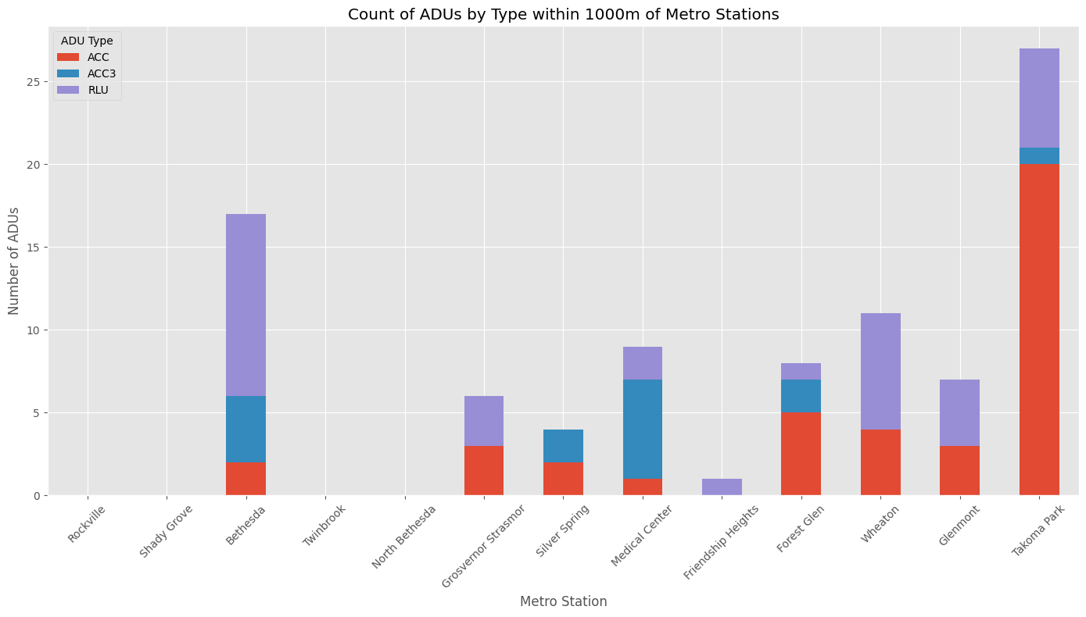
Results
Notes:
It appears that people who applied for the most RLU permits are nearby bethesda station and those whoapplied for the most ACC’’s are within takoma park, meanwhile those who applied for the most ACC3 are nearby medical center

Slide 10
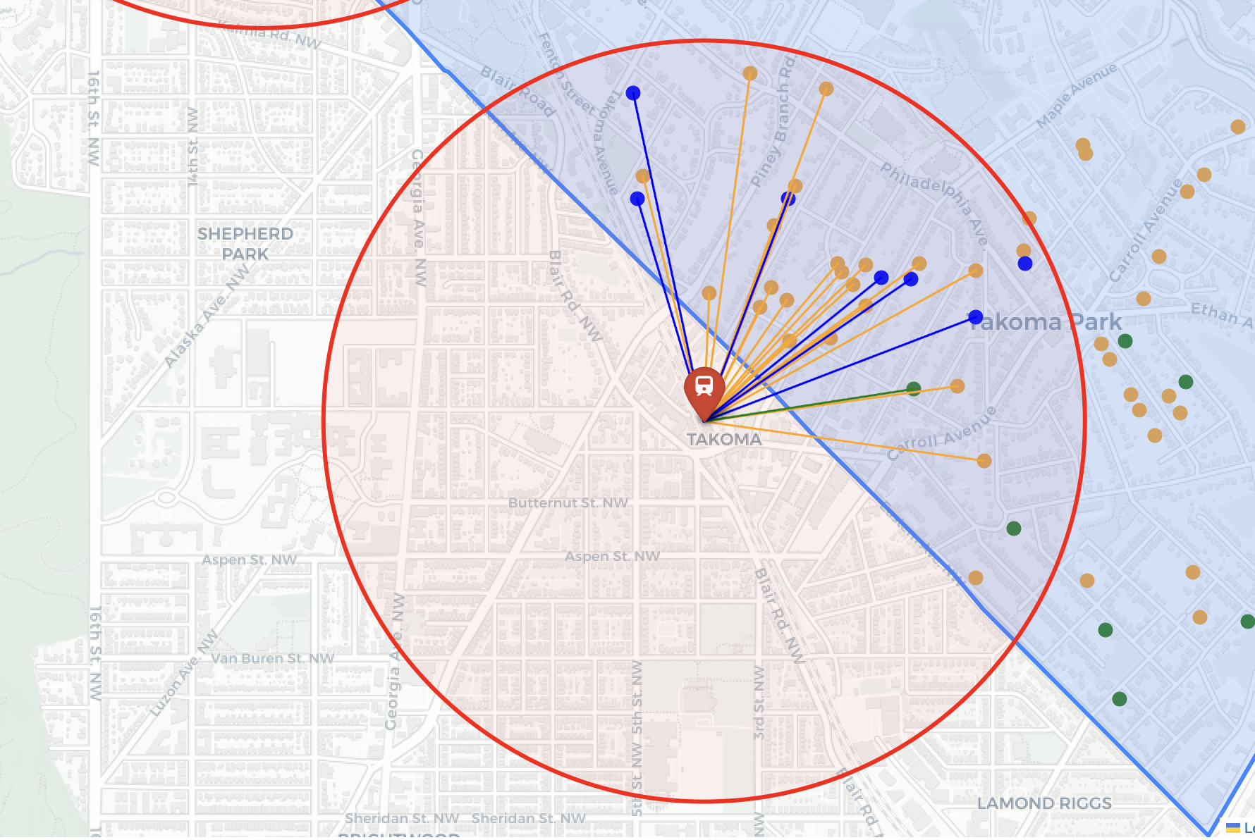
Results
Takoma
Park
Station
Notes:
We can see the higher number of acc within takoma park. Following that, we might consider researching another layer which is the socio economic aspect of the neighborhood as a trigger for the development of ADUs

Slide 11
Implications
The ADUs distribution patterns on the map do not reveal any correlation between metro stops locations and ADUs development in Montgomery County
More qualitative and quantitative research needs to be done on parking requirements, impact fees, zoning requirements, and the socio-economic aspects of Montgomery county to be able to define what has a strong correlation with ADUs development.

